Slide 1
Process Strategy
7

Slide 2
Process Strategy
The objective is to create a process to produce offerings that meet customer requirements within cost and other managerial constraints

Slide 3
Process Strategies
How to produce a product or provide a service that
Meets or exceeds customer requirements
Meets cost and managerial goals
Has long-term effects on
Efficiency and production flexibility
Costs and quality

Slide 4
Process Planning
Make-or-buy decisions
Process selection
Specific equipment selection
Process plans
Process analysis

Slide 5
Make-or Buy Example
Assume you can lease an item you need for a project for $150/day. To purchase the item, the investment cost is $1,000, and the daily cost would be another $50/day.
If you need the item for 12 days, should you lease it or purchase it?
How long will it take for the lease cost to be the same as the purchase cost?
Use Excel template

Slide 6
Make-or Buy Solution
Set up an equation so the “make” is equal to the “buy”
In this example, use the following equation. Let d be the number of days to use the item.
$150d = $1,000 + $50d
Solve for d as follows:
Subtract $50d from the right side of the equation to get
$100d = $1,000
Divide both sides of the equation by $100
d = 10 days
The lease cost is the same as the purchase cost at 10 days
If you need the item for 12 days, it would be more economical to purchase it
USE EXCEL TEMPLATE

Slide 7
Make vs Buy
See spreadsheet
A firm's must decide whether to make or buy 18,000 items used in their production line.
The costs for making the item are $98,000 annual cost and a $40 cost per item.
The costs for buying the item are $45 per item.
Should the company make or buy this item?

Slide 8
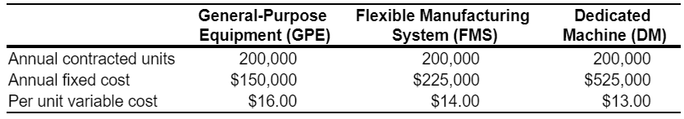
Crossover/Cost-Volume Analysis
Borges Machine​ Shop, Inc., has a​ 1-year contract for the production of 200,000 gear housings for a new​ off-road vehicle. Owner Luis Borges hopes the contract will be extended and the volume increased next year. Borges has developed costs for three alternatives. They are​ general-purpose equipment ​(GPE), flexible manufacturing system​ (FMS), and​ expensive, but​ efficient, dedicated machine​ (DM).
The cost data​ are given in the table below
The option GPE is best when the contracted volume is below 37,500 units ​(enter your response as a whole​ number).
The option FMS is best when the contracted volume is between 37,500 and 300,000 units ​(enter your responses as whole​ numbers).
The option DM is best when the contracted volume is over 300,000 units ​(enter your response as a whole​ number).

Slide 9
Process Strategies
Four basic strategies
Process focus
Repetitive focus
Product focus
Mass customization
Within these basic strategies there are many ways they may be implemented

Slide 10
Process, Volume, and Variety
Figure 7.1
Volume
Low Volume
Repetitive Process
High Volume
High Variety
one or few units per run,
(allows customization)
Process Focus
projects, job shops (machine, print, hospitals, restaurants)
Arnold Palmer Hospital
Mass Customization
(difficult to achieve, but huge rewards)
Dell Computer
Changes in Modules
modest runs, standardized modules
Variety (flexibility)
Repetitive
(autos, motorcycles, home appliances)
Harley-Davidson
Changes in Attributes (such as grade, quality, size, thickness, etc.)
high throughput and/or long runs only
Poor Strategy (Both fixed and variable costs are high)
Product Focus
(commercial baked goods, steel, glass, beer)
Frito-Lay

Slide 11
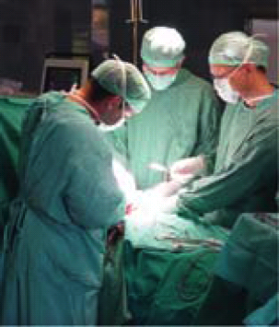
Process Focus
Many inputs
(surgeries, sick patients, baby deliveries, emergencies)
(low-volume, high-variety, intermittent processes)
Arnold Palmer Hospital
Many departments and many routings
Figure 7.2(a)
Many different outputs (uniquely treated patients)

Slide 12
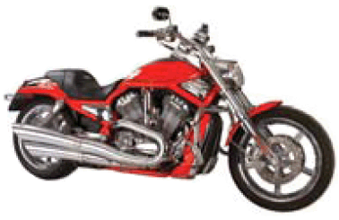
Repetitive Focus
Raw materials and module inputs
(multiple engine models, wheel modules)
Few modules
(modular)
Harley Davidson
Figure 7.2(b)
Modules combined for many
Output options
(many combinations of motorcycles)

Slide 13
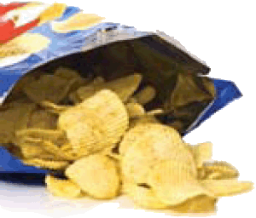
Product Focus
Few inputs
(corn, potatoes, water, seasoning)
(high-volume, low-variety, continuous process)
Frito-Lay
Output variations in size, shape, and packaging
(3-oz, 5-oz, 24-oz package labeled for each material)
Figure 7.2(c)

Slide 14

Mass Customization
Many parts and component inputs
(chips, hard drives, software, cases)
Many modules
(high-volume, high-variety)
Dell Computer
Figure 7.2(b)
Many output versions
(custom PCs and notebooks)

Slide 15
Mass Customization
TABLE 7.1 | Mass Customization Provides More Choices Than Ever
 |  | NUMBER OF CHOICES
ITEM |  | 1970s | 21ST CENTURY
Vehicle styles |  | 18 | 1,212
Bicycle types |  | 8 | 211,000
iPhone mobile game apps |  | 0 | 1,200,000
Web sites |  | 0 | 634,000,000
Movie releases per year |  | 267 | 1551
New book titles |  | 40,530 | 300,000+
Houston TV channels |  | 5 | 185
Breakfast cereals |  | 160 | 340
Items (SKUs) in supermarkets |  | 14,000 | 150,000
High-definition TVs |  | 0 | 102

Slide 16
Comparison of Processes
TABLE 7.2 | Comparison of the Characteristics of Four Types of Processes
PROCESS FOCUS (LOW-VOLUME, HIGH-VARIETY ARNOLD PALMER HOSPITAL) |  | REPETITIVE FOCUS (MODULAR HARLEY-DAVIDSON) | PRODUCT FOCUS (HIGH-VOLUME, LOW-VARIETY FRITO-LAY) | MASS CUSTOMIZATION (HIGH-VOLUME, HIGH-VARIETY DELL COMPUTER)
Small quantity and large variety of products |  | Long runs, a standardized product from modules | Large quantity and small variety of products | Large quantity and large variety of products
Broadly skilled operators |  | Moderately trained employees | Less broadly skilled operators | Flexible operators

Slide 17
Comparison of Processes
TABLE 7.2 | Comparison of the Characteristics of Four Types of Processes
PROCESS FOCUS (LOW-VOLUME, HIGH-VARIETY ARNOLD PALMER HOSPITAL) |  | REPETITIVE FOCUS (MODULAR HARLEY-DAVIDSON) | PRODUCT FOCUS (HIGH-VOLUME, LOW-VARIETY FRITO-LAY) | MASS CUSTOMIZATION (HIGH-VOLUME, HIGH-VARIETY DELL COMPUTER)
Instructions for each job |  | Few changes in the instructions | Standardized job instructions | Custom orders requiring many job instructions
High inventory |  | Low inventory | Low inventory | Low inventory relative to the value of the product

Slide 18
Comparison of Processes
TABLE 7.2 | Comparison of the Characteristics of Four Types of Processes
PROCESS FOCUS (LOW-VOLUME, HIGH-VARIETY ARNOLD PALMER HOSPITAL) |  | REPETITIVE FOCUS (MODULAR HARLEY-DAVIDSON) | PRODUCT FOCUS (HIGH-VOLUME, LOW-VARIETY FRITO-LAY) | MASS CUSTOMIZATION (HIGH-VOLUME, HIGH-VARIETY DELL COMPUTER)
Finished goods are made to order and not stored |  | Finished goods are made to frequent forecasts | Finished goods are made to a forecast and stored | Finished goods are build-to-order (BTO)
Scheduling is complex |  | Scheduling is routine | Scheduling is routine | Sophisticated scheduling accommodates custom orders

Slide 19
Comparison of Processes
TABLE 7.2 | Comparison of the Characteristics of Four Types of Processes
PROCESS FOCUS (LOW-VOLUME, HIGH-VARIETY ARNOLD PALMER HOSPITAL) |  | REPETITIVE FOCUS (MODULAR HARLEY-DAVIDSON) | PRODUCT FOCUS (HIGH-VOLUME, LOW-VARIETY FRITO-LAY) | MASS CUSTOMIZATION (HIGH-VOLUME, HIGH-VARIETY DELL COMPUTER)
Fixed costs are low and variable costs high |  | Fixed costs are dependent on flexibility of the facility | Fixed costs are high and variable costs low | Fixed costs tend to be high and variable costs low

Slide 20
Production Technology
Machine technology
Automatic identification systems (AISs)
Process control
Vision systems
Robots
Automated storage and retrieval systems (ASRSs)
Automated guided vehicles (AGVs)
Flexible manufacturing systems (FMSs)
Computer-integrated manufacturing (CIM)

Slide 21
Process Analysis and Design
Flowchart
Shows the movement of materials
Harley-Davidson flowchart
Time-Function Mapping
Shows flows and time frame

Slide 22
"Baseline" Time-Function Map
Customer
Order product
Receive product
Sales
Process order
Production control
Order
Wait
Plant A
Order
Print
Product
Warehouse
WIP
Wait
Wait
Product
Wait
Plant B
WIP
WIP
WIP
Extrude
Product
Transport
Move
Move
12 days
13 days
1 day
4 days
1 day
10 days
1 day
9 day
1 day
Figure 7.4(a)
52 days

Slide 23
"Target" Time-Function Map
Customer
Order product
Receive product
Sales
Process order
Production control
Order
Wait
Product
Order
WIP
Plant
Print
Extrude
Warehouse
Product
Wait
Transport
Product
Move
1 day
2 days
1 day
1 day
1 day
6 days
Figure 7.4(b)

Slide 24
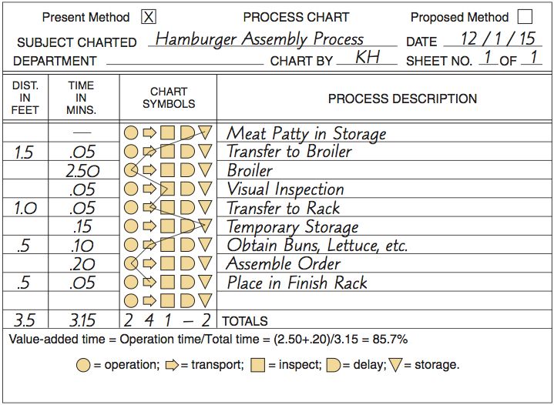
Burger Process for Chef
Text
Text
Text
Text
Text
Text
Text
Text
Text
Text
Text
Text
Text
Text
Text
Text
Figure 7.5
Text
Text
Text
Text
Assemble your process flow chart below.

Slide 25
Burger Process – SOLUTION
Figure 7.5
Patty In Storage
Transfer to broiler
Broiler
Visual inspection
Transfer to rack
Temporary storage
Obtain buns, lettuce, etc…
Assemble order
Place in finish rack

Slide 26
Service Blueprinting
Focuses on the customer and provider interaction
Defines three levels of interaction
Each level has different management issues
Identifies potential failure points

Slide 27
Service Blueprint
Personal Greeting
Service Diagnosis
Perform Service
Friendly Close
Level
#1
Customer arrives for service.
(3 min)
Customer departs
F
Determine specifics.
(5 min)
Notify customer and recommend an alternative provider.
(7 min)
Customer pays bill.
(4 min)
Warm greeting and obtain service request.
(10 sec)
No
F
Level
#2
Standard request.
(3 min)
Can service be done and does customer approve?
(5 min)
F
Direct customer to waiting room.
No
Notify customer the car is ready.
(3 min)
F
F
F
F
Yes
Yes
Level
#3
Perform required work.
(varies)
F
Prepare invoice.
(3 min)
Figure 7.7

Slide 28
Process Redesign
The fundamental rethinking of business processes to bring about dramatic improvements in performance
Relies on reevaluating the purpose of the process and questioning both the purpose and the underlying assumptions
Requires reexamination of the basic process and its objectives
Focuses on activities that cross functional lines
Any process is a candidate for redesign

Slide 29
Process Analysis and Design
Value-Stream Mapping (VSM)
Where value is added in the entire production process, including the supply chain
Extends from the customer back to the suppliers

Slide 30
Value-Stream Mapping
Begin with symbols for customer, supplier, and production to ensure the big picture
Enter customer order requirements
Calculate the daily production requirements
Enter the outbound shipping requirements and delivery frequency
Determine inbound shipping method and delivery frequency
Add the process steps (i.e., machine, assemble) in sequence, left to right
Add communication methods, add their frequency, and show the direction with arrows
Add inventory quantities between every step of the entire flow
Determine total working time (value-added time) and delay (non-value-added time)

Slide 31
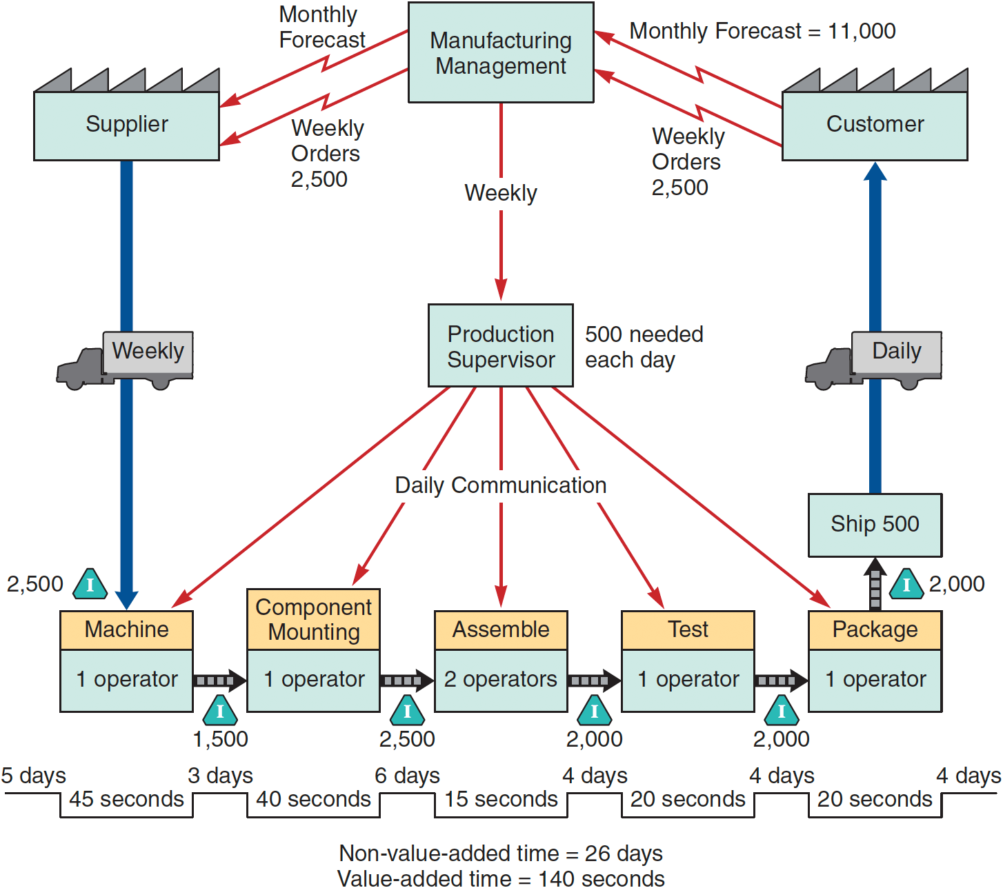
Value-Stream Mapping
Figure 7.6

